Slide 1
Default prediction model
Bene
Shinan

Slide 2
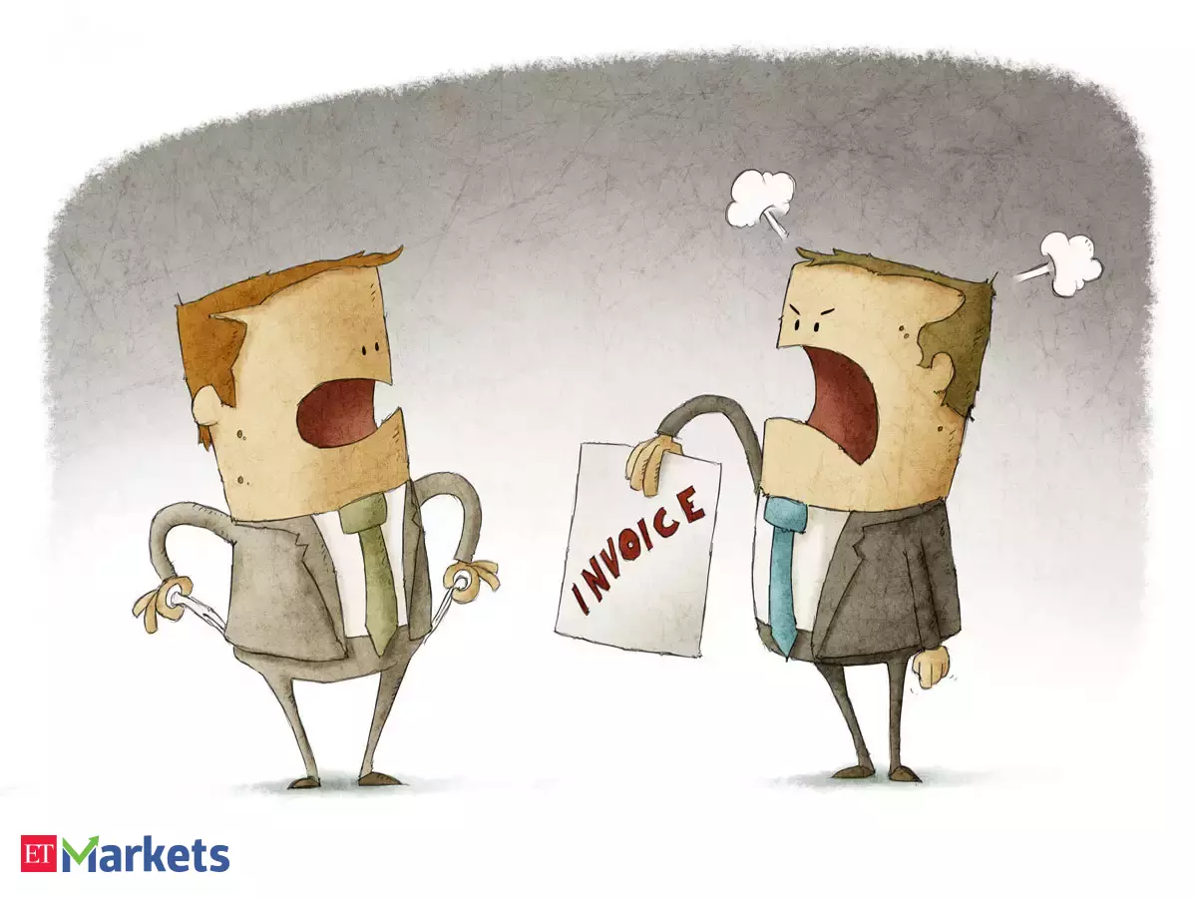
Default Risk

Slide 3
How to predict the default of a borrower? Predict the default of a borrower?
Variable | Impact

Slide 4
How to predict the default of a borrower? Heatmap

Slide 5
How to predict the default of a borrower? Who will default?

Slide 6
How to predict the default of a borrower? Default Prediction

Slide 7
How to predict the default of a borrower? FURTHER Development

Slide 8
How to predict the default of a borrower? End

